Slide 1
Database Design project
on Haramaya university club management

Slide 2
Chapter 1: Introduction Background of the organization
The Haramaya University Student Union (HUC) is the official organization representing the student body of the university.
The student union serves as a bridge between the students and the university administration, advocating for the interests and welfare of the students.
HUC has a democratic structure, with its members being elected by the student body through a free and fair election process.
The student union is led by an executive committee consisting of a president, vice president, secretary, treasurer, and other officials who oversee various aspects of the union's activities.
Overall, the Haramaya University Student Union plays a vital role in the university community, providing a voice for the students and helping to create a vibrant and engaging campus life.

Slide 3
Mission and vision of HUC
The main objective of the Haramaya University Student Union (HUC) is to promote the academic, social, and cultural interests of the students and ensure their well-being while studying at the university. HUC aims to achieve this objective through various means, including:
Advocacy: HUC advocates for the rights and interests of the students to the university administration and other stakeholders. It also raises awareness among the student body about issues affecting them and encourages them to speak up and take action.
Representation: HUC represents the students in various university committees and decision-making bodies, ensuring that their voices are heard and their needs are taken into account.
Support: HUC provides support and guidance to students in need, including academic assistance, counseling services, and financial aid.
Extracurricular activities: HUC organizes various extracurricular activities, such as sports tournaments, cultural events, and community service projects, to promote social and cultural engagement among the students.

Slide 4
Cont.
In summary, HUC hopes to accomplish several goals in the next several years that will enhance the academic, social, and cultural experiences of the students at Haramaya University, promote social justice and equality, and create positive social impact in the surrounding communities.

Slide 5
Objectives of the project
General objective: Computerize the data storage system of HUC, with the aim of improving efficiency, accuracy, and accessibility of the stored data.
Specific objectives:
Develop a database system to store and manage student data, including personal information, academic records, and extracurricular activities.
Implement a user-friendly interface that allows authorized personnel to access, edit, and update the stored data.
Develop a reporting system that generates various reports such as student enrollment, attendance, academic performance, and financial records.
Enhance the system's scalability to accommodate future growth in data storage needs.
Develop a maintenance plan to ensure that the system remains up-to-date and relevant.

Slide 6
Chapter 2: Project /work description Statement of the problem
As we have seen personally Storing data manually poses several problem including:
Inefficiency: Manual data storage is time-consuming and requires a lot of effort, making it inefficient and prone to errors.
Limited Accessibility: Accessing stored data manually can be challenging, especially when dealing with large volumes of data. This limits the accessibility of the data and makes it difficult to retrieve relevant information quickly.
Security Concerns: Manual data storage is vulnerable to data loss, theft, or damage, and can be difficult to secure. This can compromise the confidentiality, integrity, and availability of the stored data.
Lack of Integration: Manual data storage makes it difficult to integrate different data sources, which can result in data silos that hinder effective decision-making.
Data Redundancy: Manually storing data can lead to duplication of records, which can create confusion and inaccuracies in data analysis.
Limited Reporting: Manually storing data makes it difficult to generate reports and derive insights from the stored data, which can hinder effective decision-making and planning.
Overall, the manual approach to data storage in Haramaya University Clubs presents several challenges that can be addressed through computerization of the data storage system.

Slide 7
Method of the data collection
The primary purpose of this data collection was to gain a better understanding of the current data storage system, identify the challenges associated with it, and identify the requirements for a computerized data storage system.
We have collected data through:
Document analysis
Interview

Slide 8
Proposed solution to the problem:
There are several solutions that can address the problems associated with manual data storage. These solutions are:
Computerized Database System: Developing a computerized database system that is user-friendly and secure can address the challenges associated with manual data storage. The database system should be designed to store data in a structured format that allows for easy retrieval and analysis.
Automated Data Input: Automating the data input process can save time and reduce errors associated with manual data entry. This can be achieved by developing an interface that allows authorized personnel to input data into the database system.
Access Control and Backup Mechanisms: Implementing access control mechanisms, such as password protection and user roles, can ensure that only authorized personnel can access sensitive data. Backup mechanisms, such as cloud storage or external hard drives, can ensure that data is not lost or damaged.
Staff Training and Support: Providing training and support to HUC staff on the new computerized data storage system can ensure a smooth transition from manual to digital storage. This can involve providing training on how to use the new system and troubleshooting common issues.
Automated Reporting: Automating the reporting process can allow for easy retrieval and analysis of data, which can improve decision-making and planning. This can be achieved by developing a reporting module within the database system.
Testing and Debugging: Conducting thorough testing and debugging of the new computerized data storage system can ensure that it is functioning optimally and free from errors.
Scalability: Developing a system that is scalable can ensure that it can accommodate future growth in data storage needs. This can involve using scalable cloud-based solutions or designing the system with expansion in mind.

Slide 9
Chapter Three: Database design
The entities existing in the organization
The entities existing in the organization are:
Club: This entity represents the different clubs that exist within the university, such as the debate club, music club, and sports club.
Club Member: This entity represents the individual students who are members of the various clubs.
Club Executive: This entity represents the individuals who hold executive positions within the clubs, such as the president, vice-president, and secretary.
Club Advisor: This entity represents the faculty or staff member who serves as an advisor to each club.
Event: This entity represents the different events that each club organizes, such as competitions, performances, and social events.
Attendance: This entity represents the attendance of club members at various club events.
Finance: This entity represents the financial transactions associated with each club, such as budgeting, fundraising, and expenditure.

Slide 10
The relationship exist among these entities
The relationship exist among these entities are:
Club and Club Member: This is a one-to-many relationship, where each club can have multiple members, but each member can belong to only one club.
Club and Club Executive: This is a one-to-many relationship, where each club can have multiple executives, but each executive can hold only one position in one club.
Club and Club Advisor: This is a one-to-one relationship, where each club has one advisor, and each advisor can advise only one club.
Club and Event: This is a one-to-many relationship, where each club can organize multiple events, but each event is organized by only one club.
Event and Attendance: This is a one-to-many relationship, where each event can have multiple attendance records, but each attendance record is associated with only one event.
Club Member and Attendance: This is a many-to-many relationship, where each club member can attend multiple events, and each event can have multiple attendees.
Club and Finance: This is a one-to-many relationship, where each club can have multiple financial transactions, but each transaction is associated with only one club.

Slide 11
Designing Conceptual Schema
When designing a database for the Haramaya University Club Management System, the following are some of the most relevant information that should be stored for each entity and relationship:
Club: Club name, description, date of establishment, club advisor, club executives, and club members.
Club Member: Member ID, name, contact information, date of joining the club, and club(s) they belong to.
Club Executive: Executive ID, name, position, date of appointment, and the club they belong to.
Club Advisor: Advisor ID, name, contact information, and the club they advise.
Event: Event ID, name, description, date, time, location, organizer (club), and attendees.

Slide 12
Cont.
For each relationship, the following information should be stored:
Club and Club Member: The ID of the club and the ID of the club member.
Club and Club Executive: The ID of the club and the ID of the club executive.
Club and Club Advisor: The ID of the club and the ID of the club advisor.
Club and Event: The ID of the club and the ID of the event.
Event and Attendance: The ID of the event and the ID of the attendance record.
Club Member and Attendance: The ID of the club member and the ID of the attendance record.
Club and Finance: The ID of the club and the ID of the financial transaction.

Slide 13
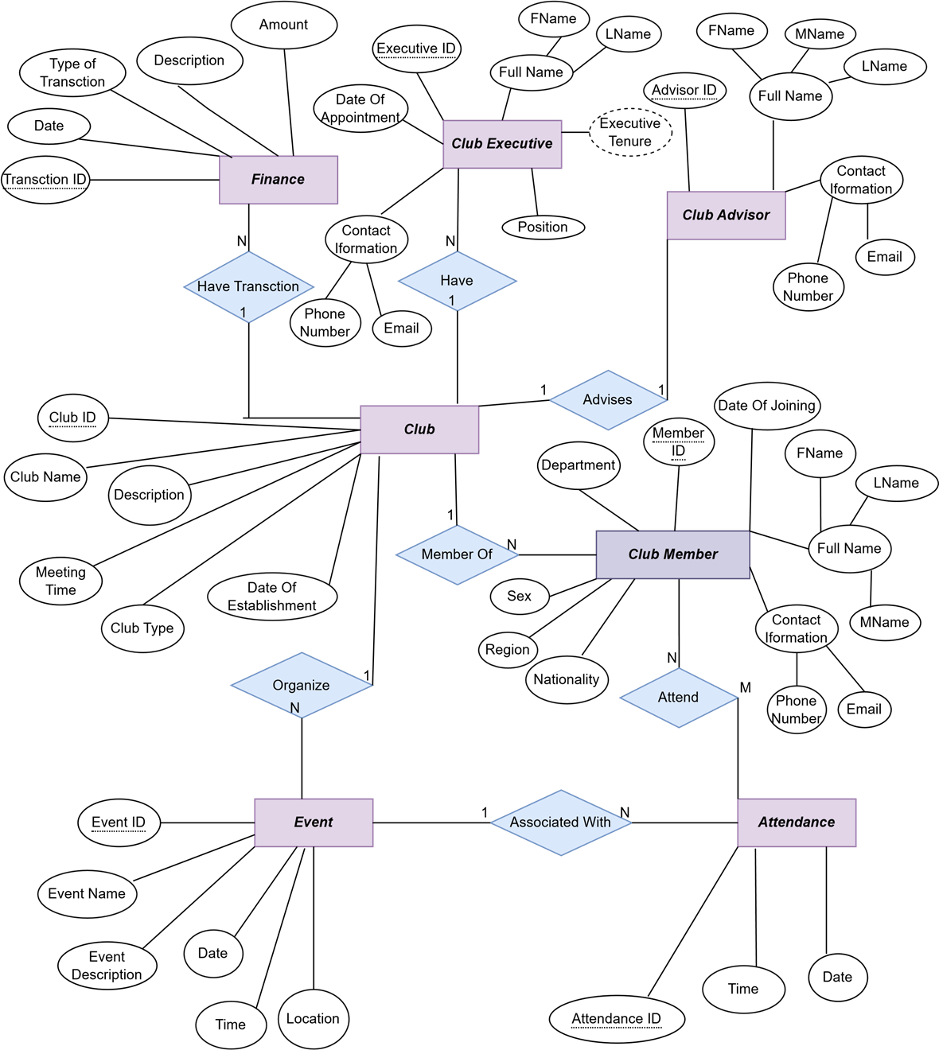
Diagram of the E-R model for hucms

Slide 14
Converting the ER-diagram in to relational table
Club table 1: club_info table:
Club executive table 2:
Club member table 3:
Club_ ID | Trans_ ID | Date | type of trans | amount
C001 | TR01 | 2200-07-08 | BUISNESS TRANSECTION | 780.00000
C002 | TR02 | 1988-09-08 | EXTERNAL TRANSECTION | 456777.0000
C003 | TR03 | 1988-09-08 | CASH TRANSECTION | 677780.56480
Club ID | Club Name
C001 | HUSESA Club
C002 | HULSA Club
Executive id | Name | Possession | Date of appointment | Club id
2407 | Abdul Fatah Jamaal | President | 1990 | C001
4433 | Bonsa Baker | Secretary | 1999 | C002
Member id | First Name | Last name | Club id | Contact information | Date | Club id
2405 | Abdiisaa | Able | C003 | 0949303825 Bdtre654@gmail.com | 1992-09-09 | C001
2402 | Eyuel | Kamal | C004 | 0945654339 Uytr$dew@gmail.com | 1995-09-07 | C002

Slide 15
Cont.
Event table 4:
Finance table 5:
Club advisor table 6:
Attendance table 7:
Event id | Name | Description | date | Time | Location | Club id | Attended id
E001 | Science | A science description | 1990-07-30 | 4:00am | HU | C001 | 4356
E002 | Football | a football description | 1993-07-24 | 2;00 am | Stadium | C002 | 3456
Transection id | Club id | Amount | date | Type | Description
T001 | Coo1 | 1000 | 1992-08-25 | For research | Balance sheet
T002 | C002 | 4500 | 1999-09-04 | For equipment | Cash flow
Advisor id | First name | Last name | Contact information | Club id
A001 | Barkegn | Kebede | 0956764598 Gajkra%@gmail.com | C003
A002 | Asrat | Werku | 0956785456 Yt657#@gmail.com | C004
Event id | Club member id | Date | Time | Attendance id
E004 | C004 | 1990-07-21 | 8:23 | A001
E005 | C005 | 1990-09 -12 | 9:25 | A002

Slide 16
Applying the normalization rules
Club table 8:
Club advisor table 9:
Club member table 10:
Club ID | club name | Advisor id
C001 | Science club | A001
C002 | Football club | A002
Advisor ID | Advisor name | Contact information
A001 | Barkegn | 0956764598
A002 | Asrat | 0956785456
Member ID | First Name | Last name | Contact information
2405 | Abdiisaa | Able | 0949303825
2402 | Eyuel | Kamal | 0945654339

Slide 17
Cont.
Event table 11:
Attendance table 12:
In this normalized version of the tables, there is no redundant data and all data is stored in the appropriate tables.
The relationships between the tables are defined through the use of foreign keys.
Event.id | Club.id | Event Name | Date
E001 | C001 | Science | 1990-07-30
E002 | C002 | Football | 1993-07-24
Event.id | Club Member.id
E004 | C004
E005 | C005

Slide 18
Chapter Five: Conclusion and Recommendation
Conclusion:
Haramaya University Club Management system is a valuable tool for managing club activities and data at the university.
The manual process of storing and managing data had several limitations, which the system has addressed by providing an efficient and effective way of managing club membership, events, finances, and attendance.
Through the system, data accuracy and availability have been improved, workload reduced, and overall management enhanced.
Recommendation:
We expect from the system work to expand the system to incorporate more clubs and improving its scalability and flexibility.
Additionally, there is a need for training and capacity building for club administrators and members to effectively use the system.
Overall, the Haramaya University Club Management system has significant implications for the efficient management of club activities and data at the university, and its benefits can be leveraged by expanding its use and improving its capabilities.

Slide 19
Thank you
End of the slide

